Slide 1
ROBUST BLOCKCHAIN ENABLED DATA STORAGE AND CLOUD-BASED INTEGRITY AUDITING FOR ENHANCED SECURITY.
Team members
Ragul Anastraj.M (820621104064)
Sabarish Kumar.S (820621104070)
Saravana.G (820621104076)
Prasanna.S (820621104312)
Guided by,
Mr.S.V.Karthik,M.Tech.,A.M.I.E.,
Assistant Professor,
Department of CSE.

Slide 2
ABSTRACT
Secure sharing of dynamic audit data is automatically performed through the consensus strategy and highly programmable smart contracts.
Blockchain technology has become one of the most important emerging technologies in this period
In proposed work, the auditor is required to create a new transaction after every verification where the information corresponding to the verification is integrated into the transaction, and the auditor conducts the transaction.
After the transaction is recorded into the blockchain, the user is able to verify the time when the auditor performs the verification by checking the generation time of the transaction.

Slide 3
LITERATURE SURVEY
S.No | Author (Year) | Title | Technique | Merit | Demerit
1 | M Keshk, B Turnbull, E Sitnikova, D Vatsalan (2021) | Privacy-preserving schemes for safeguarding heterogeneous data sources in cyber-physical systems | Privacy-preserving schemes | Protects diverse data sources while maintaining usability | Complexity in implementation
2 | AA Abi Sen, FA Eassa, K Jambi, M Yamin (2018) | Preserving privacy in internet of things: a survey | Survey of IoT privacy techniques | Comprehensive overview of existing privacy methods in IoT | Limited implementation details
3 | A Majeed, SO Hwang (2025) | Solving Truthfulness-Privacy Trade-off in Mixed Data Outsourcing by Using Data Balancing and Attribute Correlation-Aware Differential Privacy | Differential privacy | Manages the trade-off between privacy and truthfulness | May reduce data utility sometimes
4 | S Ahamed, M Siddika, S Islam, S Anika (2021) | BPS: Blockchain based decentralized secure and versatile light payment system | Blockchain technology | Enhances security and decentralization of payment systems | Scalability issues with blockchain
5 | G Xu, H Li, Y Dai, K Yang, X Lin (2018) | Enabling efficient and geometric range query with access control over encrypted spatial data | Access control over encrypted data | Efficient querying method for spatial data with privacy | Increased computational complexity

Slide 4
EXISTING SYSTEM
The auditor verifies the outsourced data integrity at the corresponding time.
In practice, the auditor generates a verification report containing multiple verification results
If in any period the verification result is “Reject”, it means that the data may be corrupted and the auditor needs to inform the user at once
Consequently, these schemes suffer from the certificate management problem including certificate revocation, storage, distribution, and verification, which is very costly and cumbersome.

Slide 5
DISADVANTAGE
Cannot resist a procrastinating auditor who may not perform the data integrity verification on schedule
Deviate from the original objective of public verification schemes.
It might be too late to recover the data loss or damage if the auditor procrastinates on the verification.
The procrastinating auditor also cannot be detected in the public verification schemes, even though malicious auditors can be detected there

Slide 6
PROPOSED SYSTEM
In this proposed work the first certificate less public data integrity verification scheme (CPVPA) was implemented that resists malicious and procrastinating auditors.
The key idea behind CPVPA is to use blockchain technology, which provides a tamper-proofing and distributed way to conduct transactions without a central authority (i.e., bank).
The proposed scheme also supports public auditing using a TPA (Third Party Auditor) to help low-powered clients.
The proposed scheme satisfies all fundamental security requirements, and is more efficient than the existing schemes that are designed to support deduplication and public auditing at the same time.

Slide 7
ADVANTAGES
Allows the cloud server to prove that the outsourced data is well maintained.
The communication and computation overhead should be as efficient as possible.
Collusion between any two participants cannot break the security of the proposed scheme.

Slide 8
SYSTEM REQUIREMENTS
HARDWARE REQUIREMENTS
Processor : Dual core processor 2.6.0 GHZ
RAM : 4 GB
Hard disk : 320 GB
Keyboard : Standard keyboard
Monitor : 15 inch color monitor
SOFTWARE REQUIREMENTS
Operating system : Windows OS
Back End : Python
Database : SQL SERVER
IDLE : PyCharm

Slide 9
ALGORITHM
SHA-256 Hashing Algorithm – For data integrity.
AES (Advanced Encryption Standard) – For file encryption.
Blockchain Transaction Protocol – For recording verification results.

Slide 10
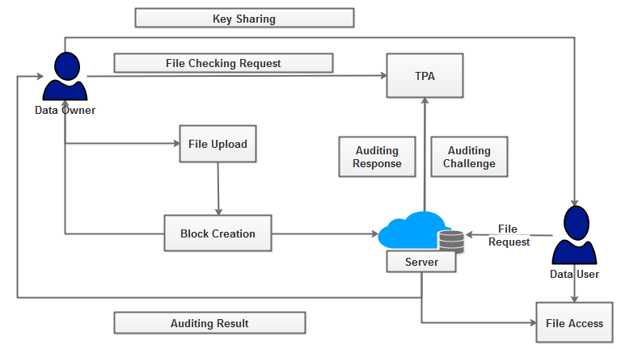
SYSTEM ARCHITECTURE

Slide 11
DATA FLOW DIAGRAM-LEVEL 0
Data Owner
Register
Get Approval
Cloud Access
BC Data Storage

Slide 12
DATA FLOW DIAGRAM-LEVEL 1
Data Owner
Login
Upload Data
Data Encryption
Block Creation
BC Cloud Storage

Slide 13
DATA FLOW DIAGRAM-LEVEL 2
Data Audit Request
Data Owner
Audit Challenge
Cloud Storage
TPA
Audit Proof

Slide 14
DATA FLOW DIAGRAM-LEVEL 3
Send File Request
Data User
Access Permission
Cloud Storage
Data User
Data Retrieval

Slide 15
UML DIAGRAMS-USECASE DIAGRAM

Slide 16
CLASS DIAGRAM

Slide 17
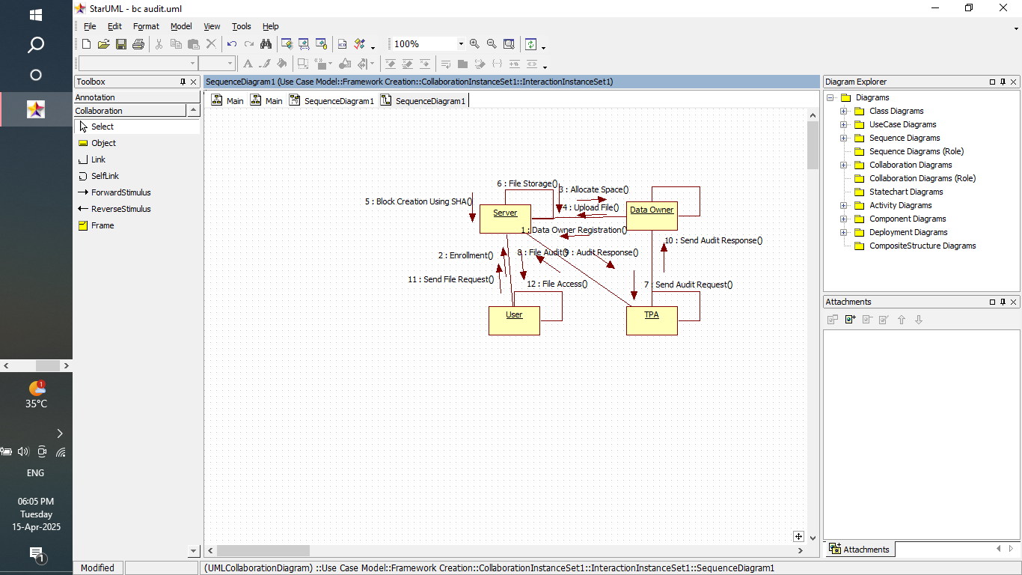
COLLABORATION DIAGRAM

Slide 18
SEQUENCE DIAGRAM

Slide 19
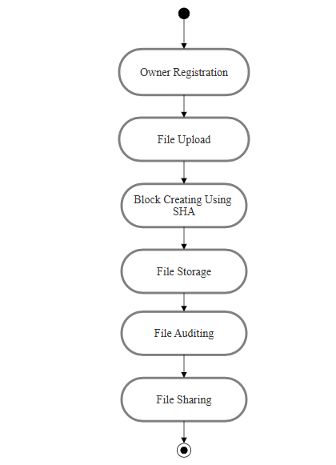
ACTIVITY DIAGRAM

Slide 20
MODULES
Block Chain Storage Framework
User Enrolment
Data Block Creation
Data Auditing
Secure Data Sharing

Slide 21
MODULE DESCRIPTION
BLOCK CHAIN STORAGE FRAMEWORK
The storage scheme of data uses blockchain based cloud storage technology to achieve safe storage and sharing.
In this module, create a local Cloud and provide priced abundant storage services.
Data storage and access control are the main transactions in the medical blockchain.
It would be optimal to be able to hold all medical data on the blockchain.

Slide 22
MODULE DESCRIPTION
USER ENROLMENT
Before a user can be access to the system, he has to be registered with the system for the first time.
So, for a new user, he has to get registered with a system and then authenticated before he can request server.
In a basic authentication process, a user presents some credentials like user ID to prove that the user is the true owner of the user ID.
Data owner could upload the file on cloud. Once the file is stored in cloud, the file will get encrypted.

Slide 23
MODULE DESCRIPTION
DATA BLOCK CREATION
Blockchain technology functions are reliable for use in a hashing crypto method, which helps create an adequate and strong hashing code and convert it from a bit of fixed size data to strings of character.
Each transaction proposed in a blockchain are hashed together before shoving in a block, and the hash pointers connect each block to the next block for holding of previous hash data as it is undisputable

Slide 24
MODULE DESCRIPTION
DATA AUDITING
TPA works for the user. It feeds back the verification results to the user and the cloud server, and detects the data corruption as soon as possible.
The communication between TPA and other entities is authenticated. The verification period is determined by the user
Upon receiving the challenging message, the cloud server computes the corresponding proof.
TPA checks the validity of the proof to verify the data integrity. If the checking fails, TPA informs the user that the data may be corrupted.

Slide 25
MODULE DESCRIPTION
DATA AUDITING
TPA works for the user. It feeds back the verification results to the user and the cloud server, and detects the data corruption as soon as possible.
The communication between TPA and other entities is authenticated. The verification period is determined by the user
Upon receiving the challenging message, the cloud server computes the corresponding proof.
TPA checks the validity of the proof to verify the data integrity. If the checking fails, TPA informs the user that the data may be corrupted.

Slide 26
MODULE DESCRIPTION
DATA SHARING
In the data sharing concept storage server is most important module. The storage data store the huge amount of data.
This data is securely store in storage server. It also store encrypted data and key which used for data encryption.
When the user requires his data, user requests to the storage server.

Slide 27
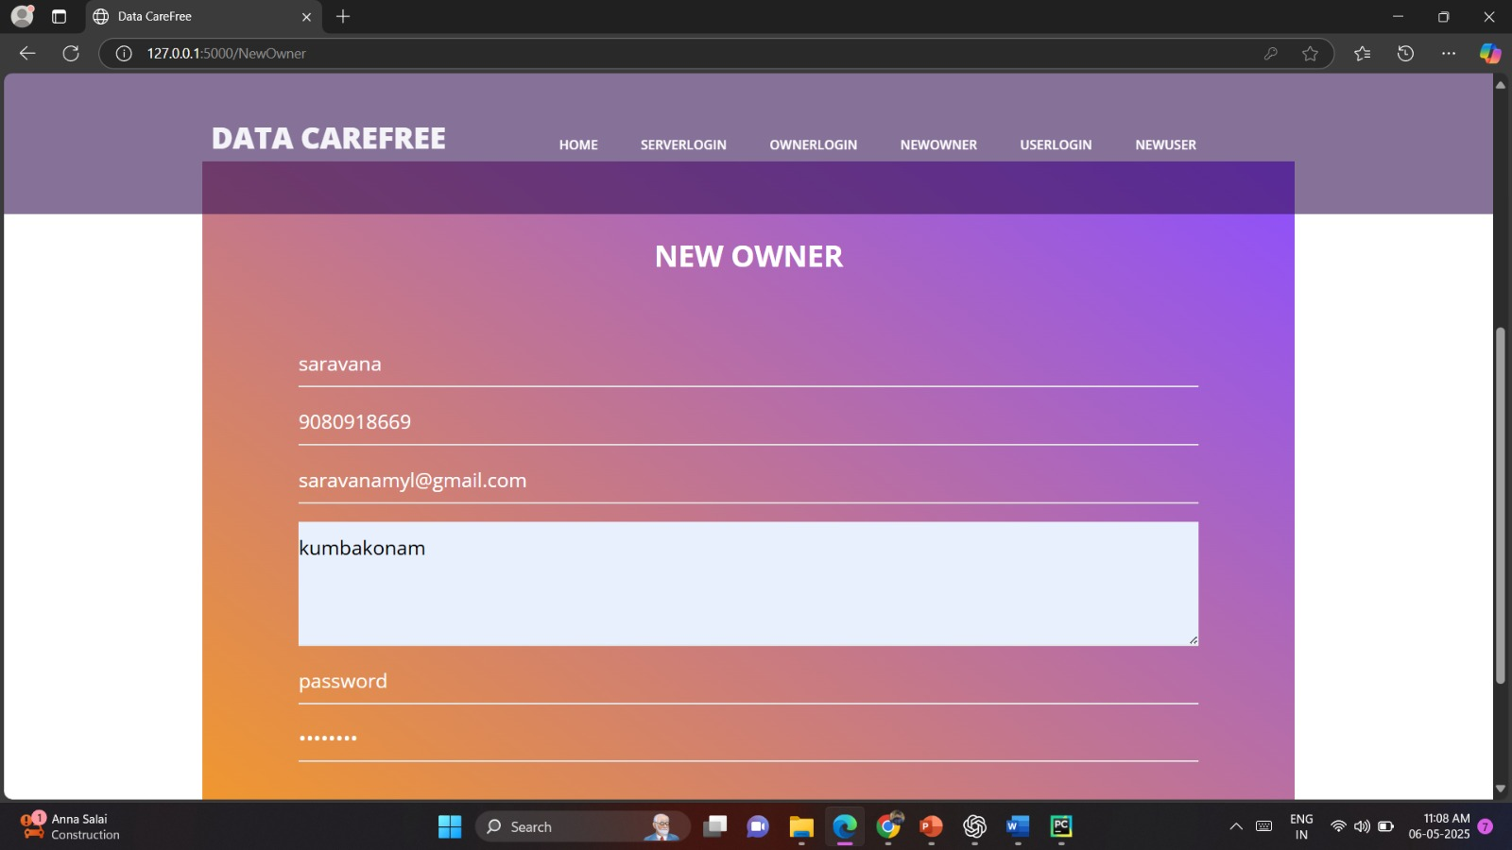
New Owner

Slide 28
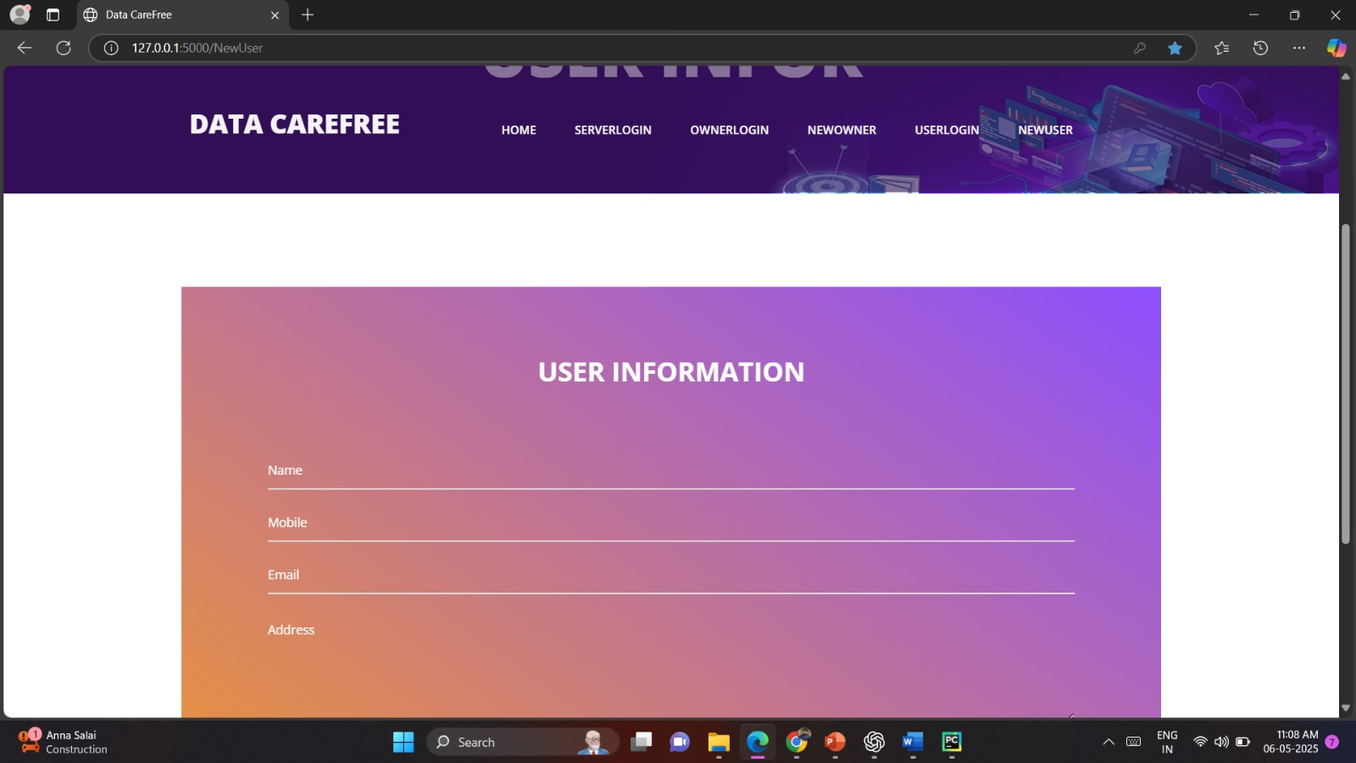
User Information

Slide 29
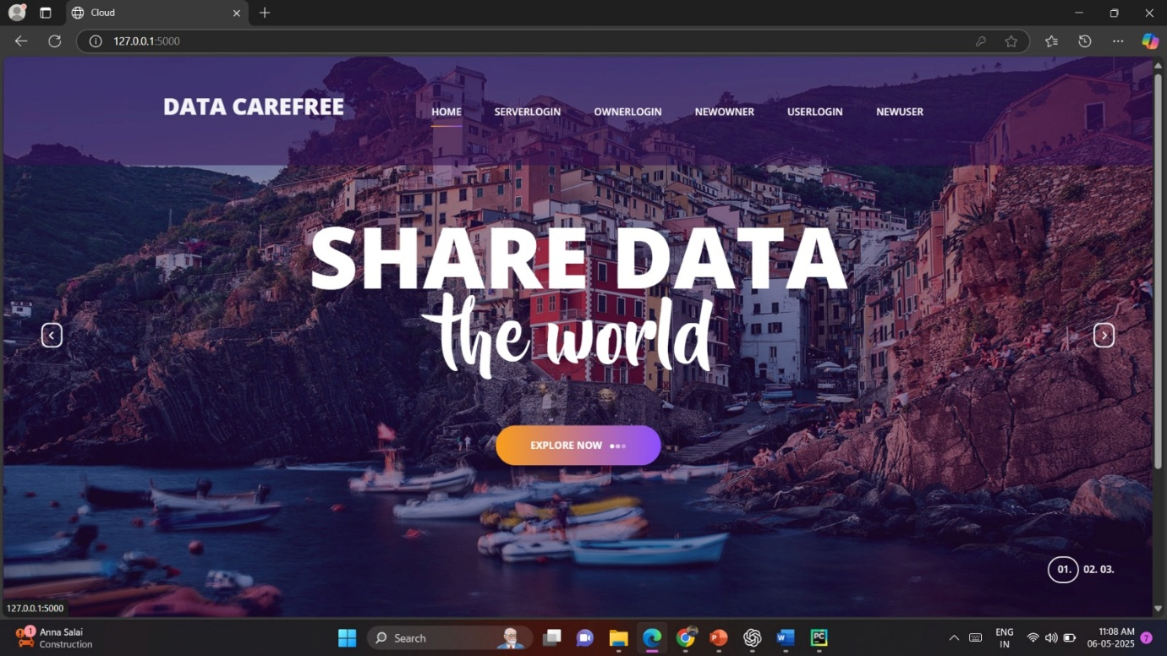
Home Page

Slide 30
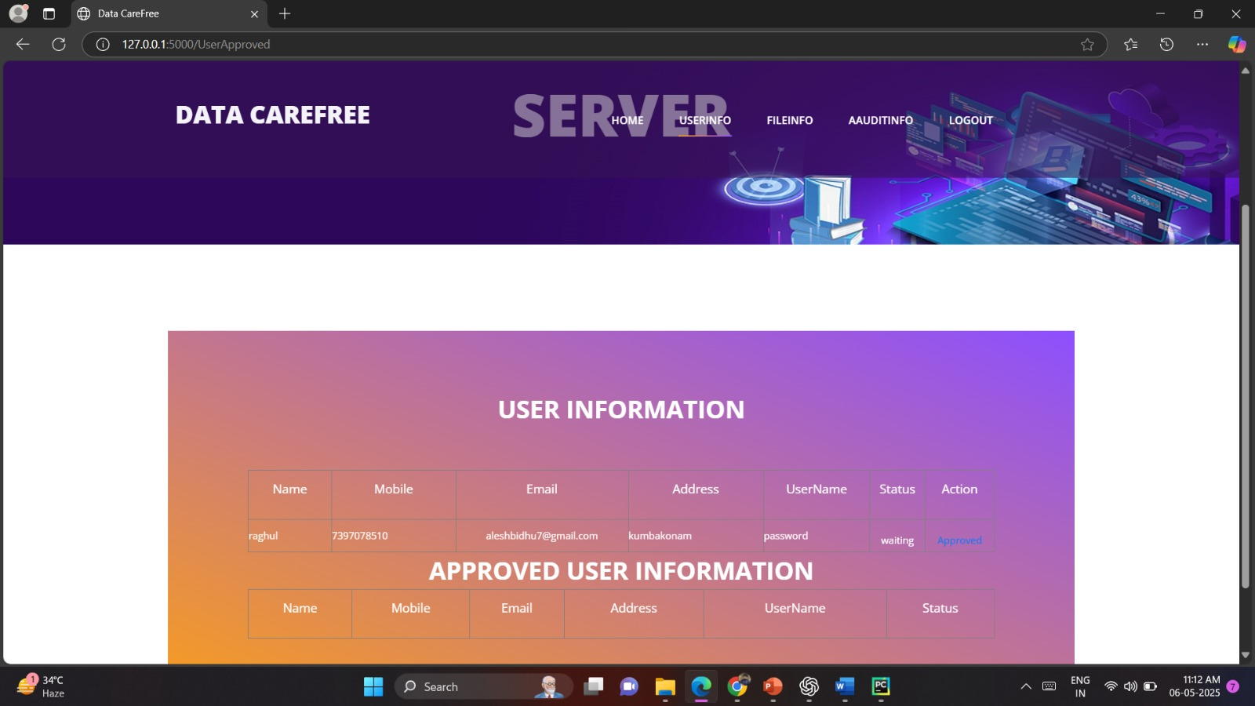
User Info

Slide 31
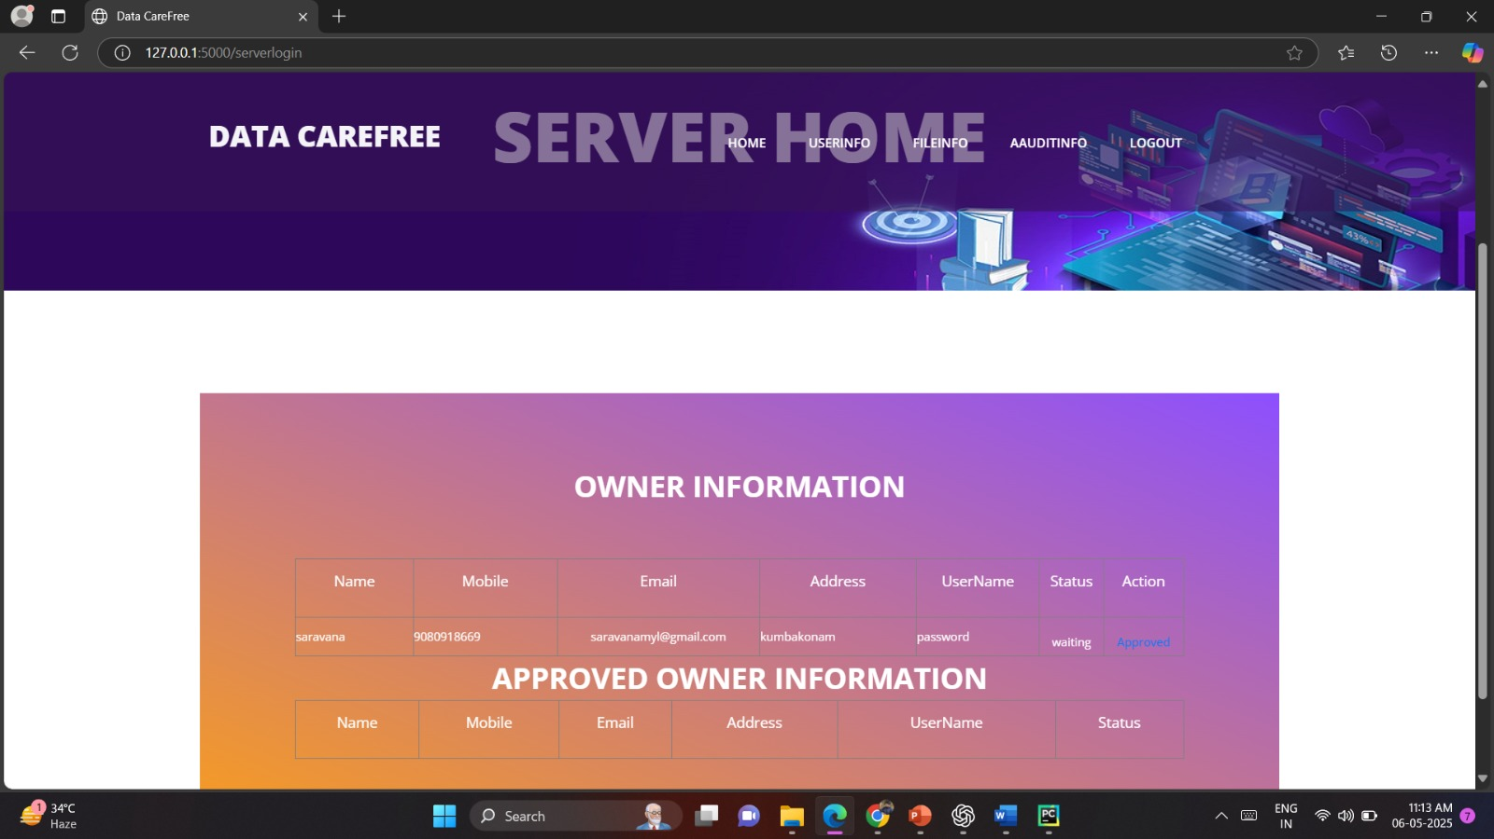
Owner Information

Slide 32
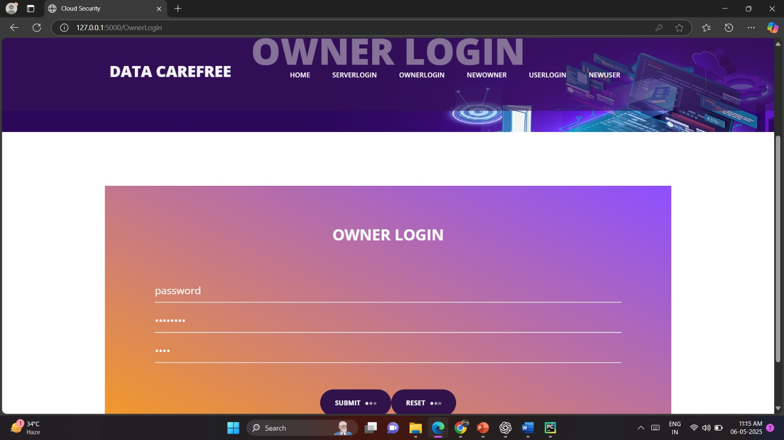
Owner Login

Slide 33
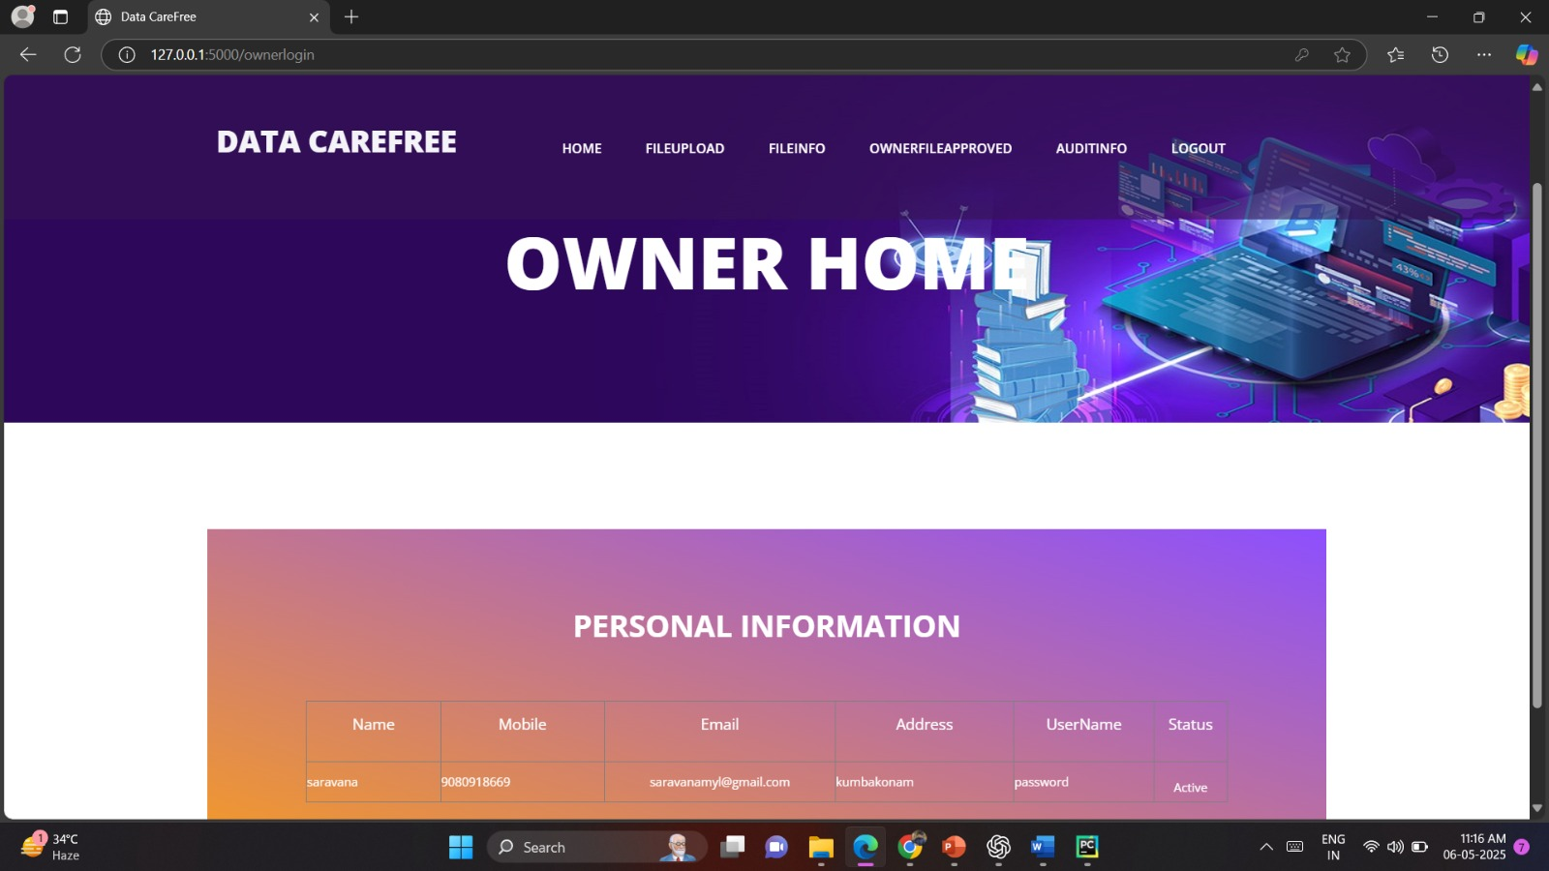
Owner Home

Slide 34
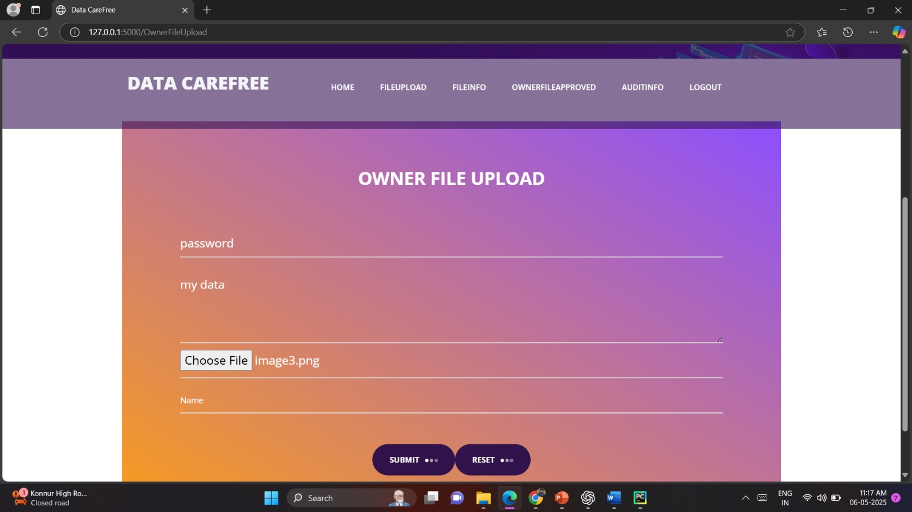
Owner File Upload

Slide 35
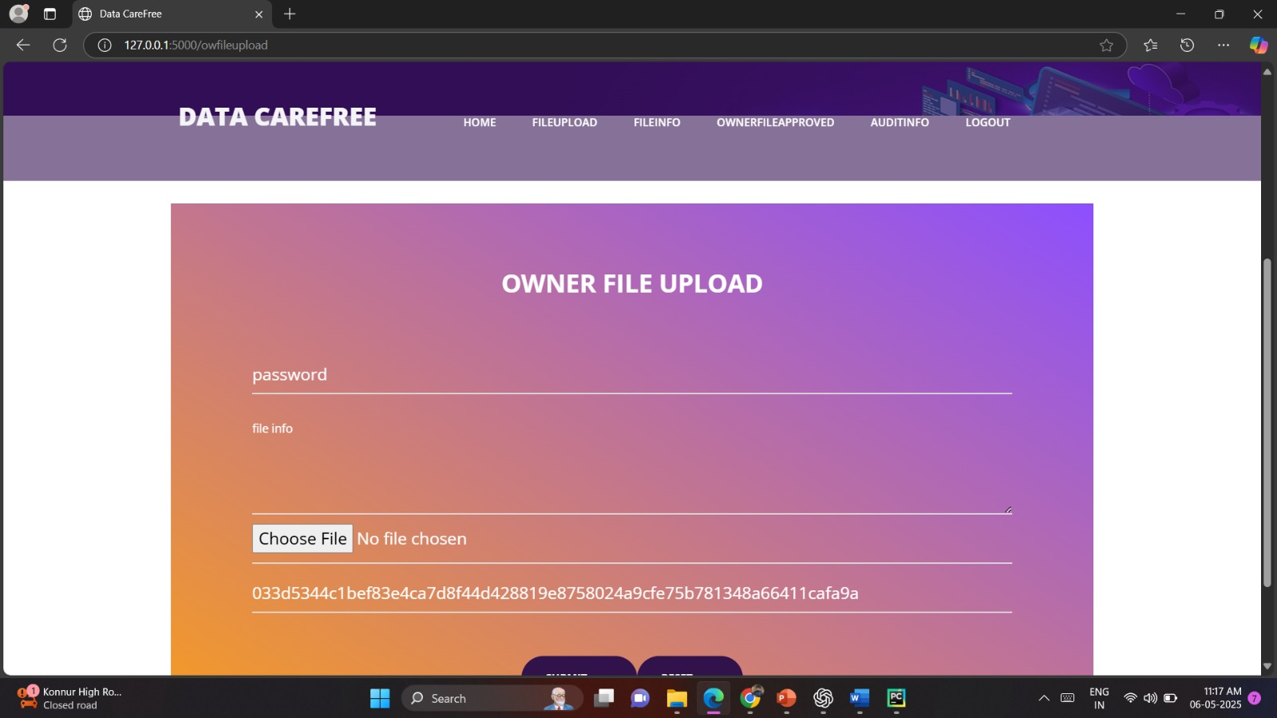
Owner File Upload

Slide 36
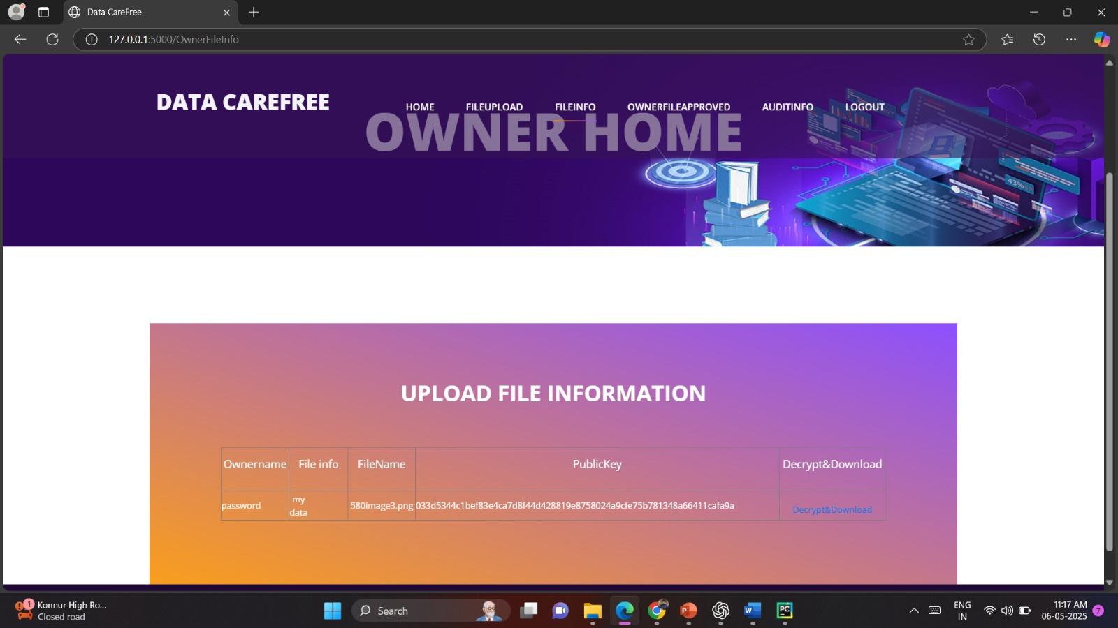
Upload File Information

Slide 37
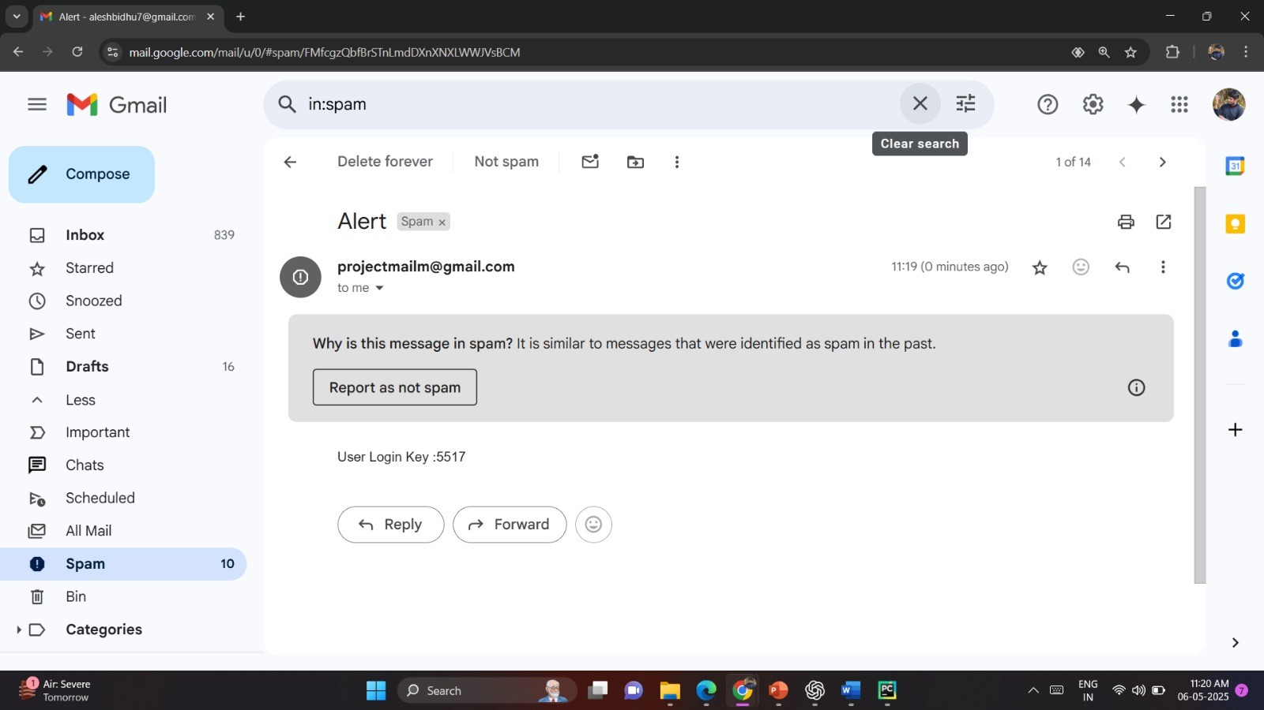
User Login Key

Slide 38
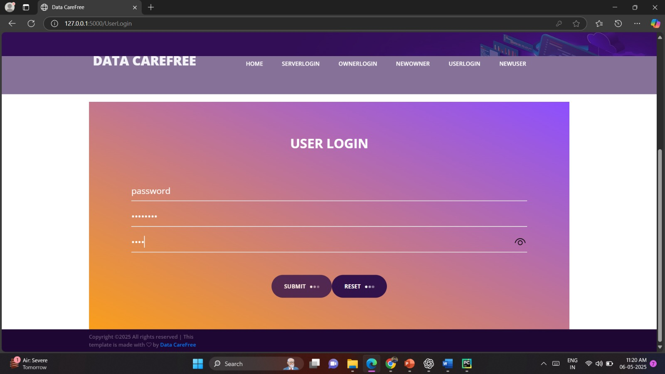
User Login

Slide 39
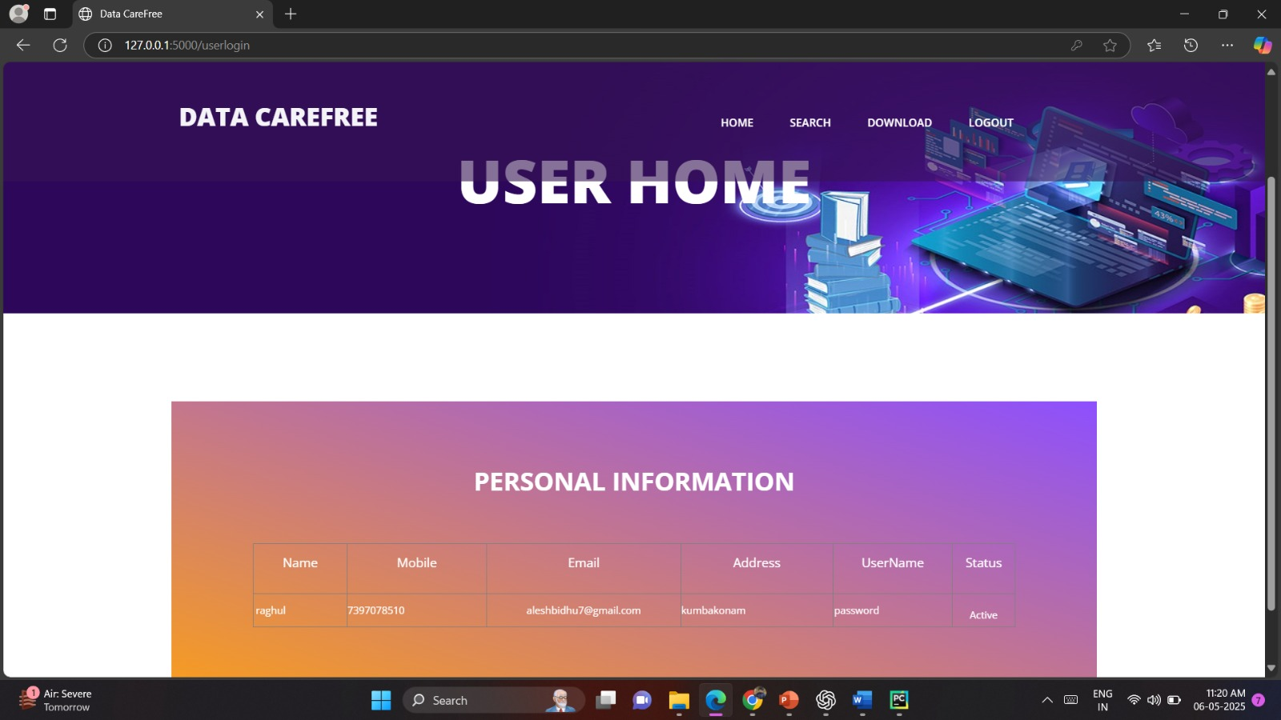
Personal Information

Slide 40
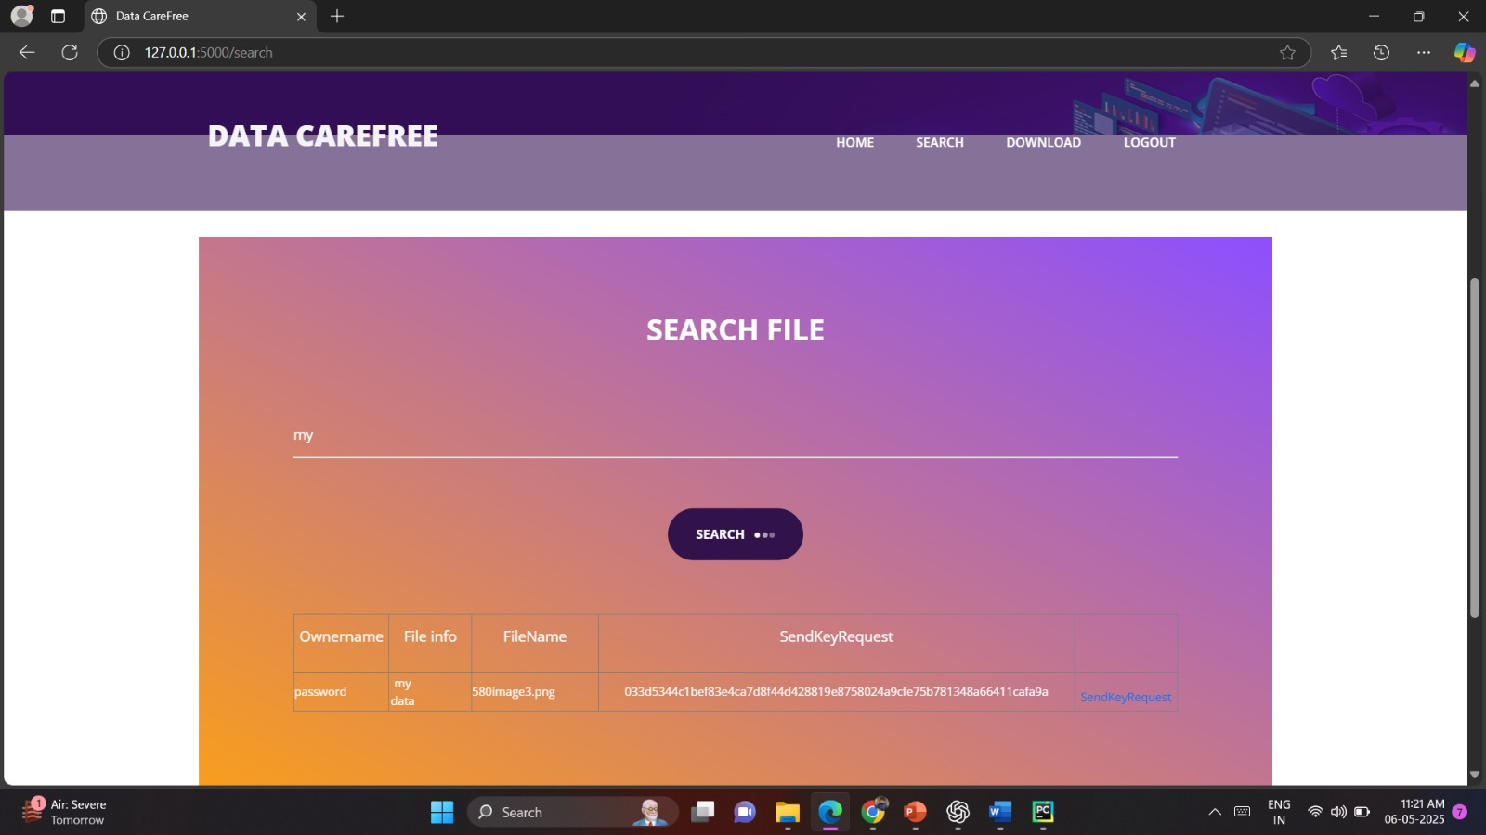
Search File

Slide 41
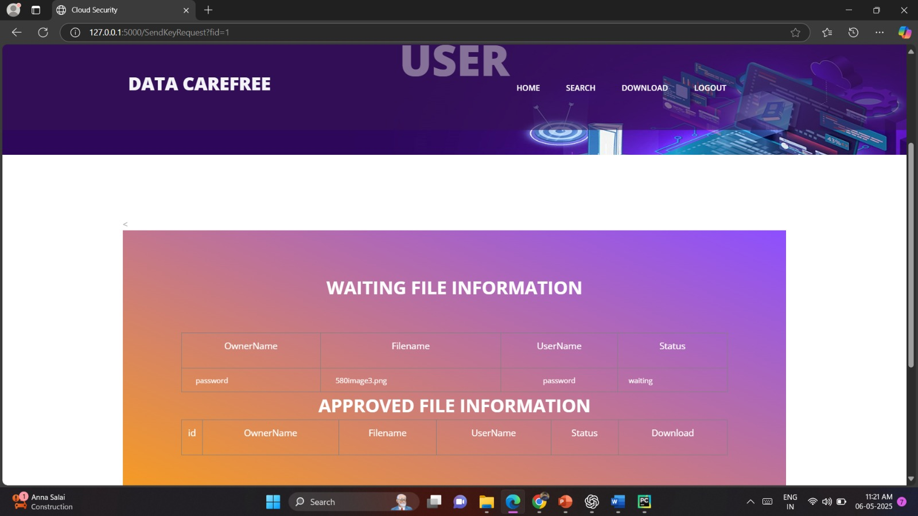
Approved File Information

Slide 42

Download File Information

Slide 43
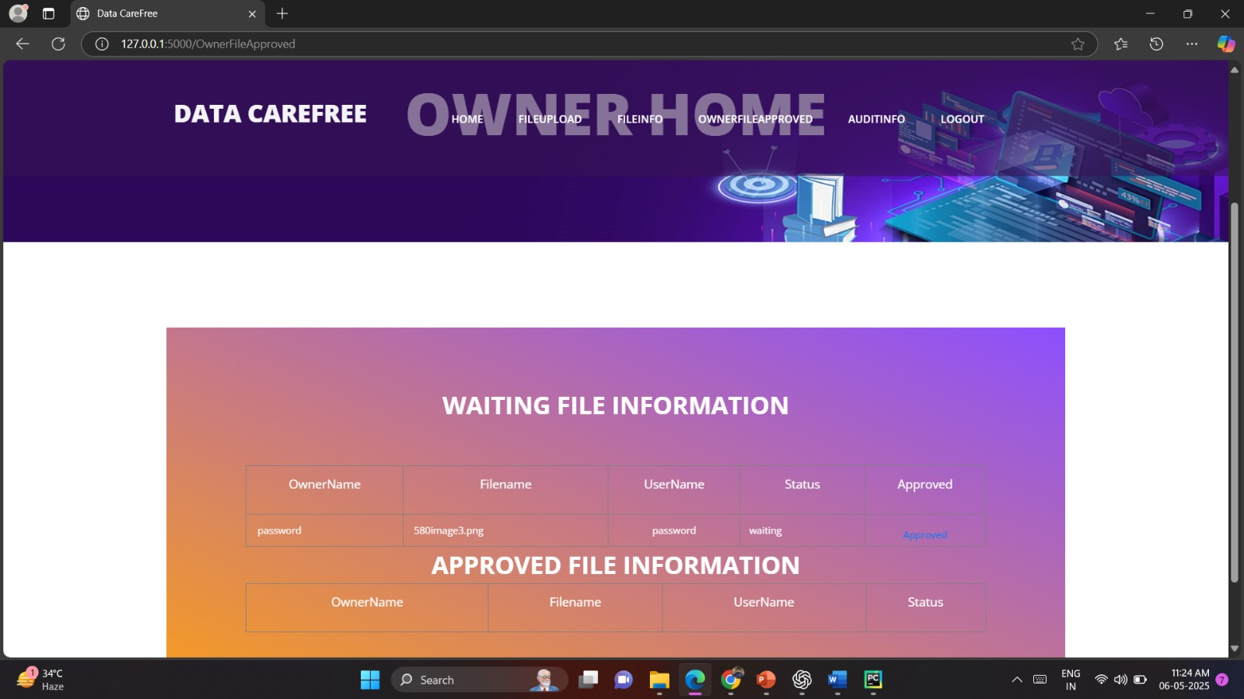
Approved file

Slide 44
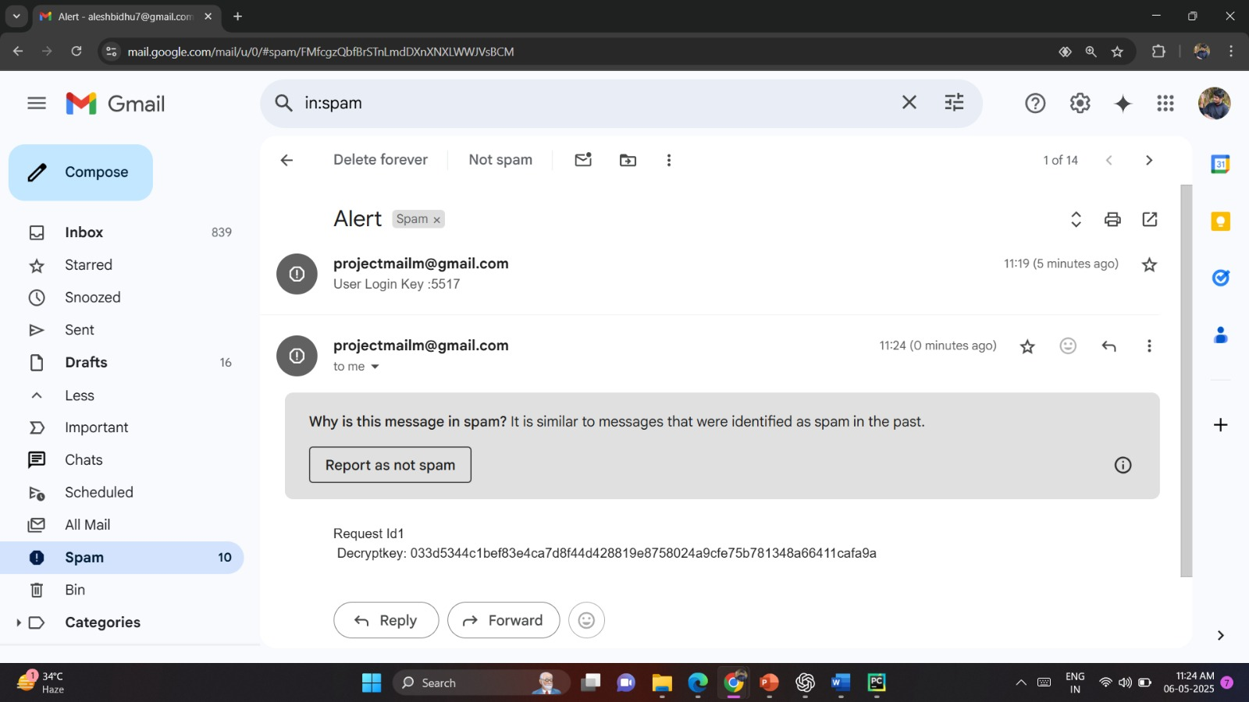
Decrypt key

Slide 45
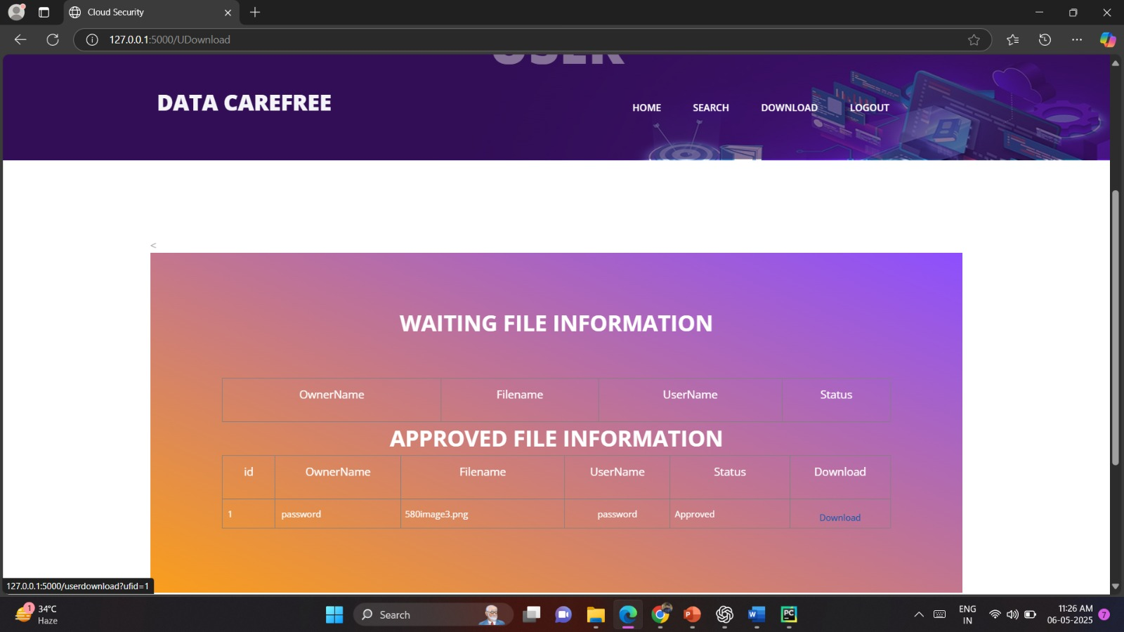
Download to Approved File

Slide 46
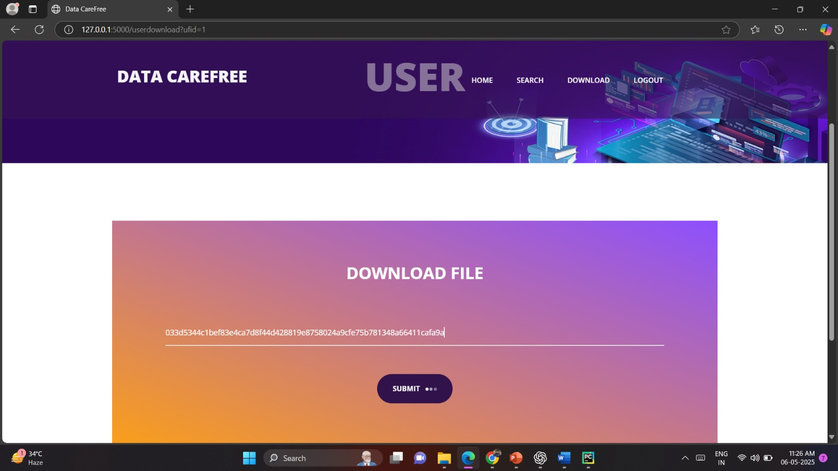
Decrypt key

Slide 47
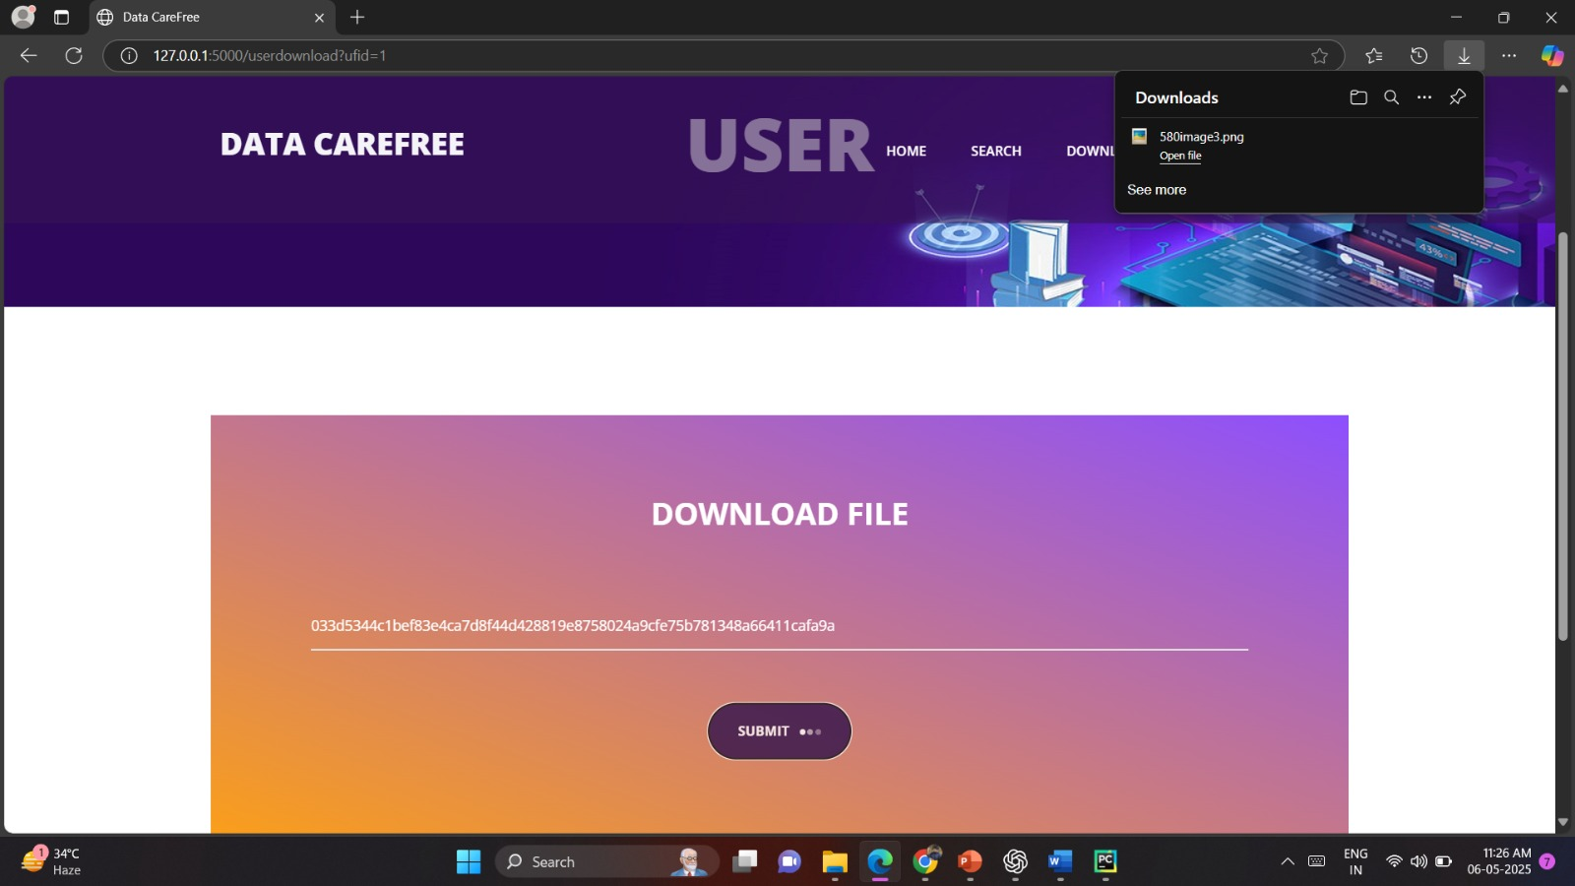
Download File

Slide 48
FUTURE ENCHANCEMENT
For the future work, we will investigate how to construct CPVPA on other blockchain systems. Since the main drawback of proofs of work (PoW) is the energy consumption, constructing CPVPA on other blockchain systems (e.g., proofs-of-stake-based blockchain systems) can save energy. However, it requires an elaborated design to achieve the same security guarantee while ensuring the high efficiency. This remains an open research issue that should be further explored.

Slide 49
CONCLUSION
Here proposed a certificate less public verification scheme against the procrastinating auditor, namely CPVPA. This proposed work utilizes the on-chain currencies, where verification performed by the auditor is integrated into a transaction on the blockchain of on-chain currencies. Furthermore, the proposed system is free from the certificate management problem. The security analysis demonstrates that CPVPA provides the strongest security guarantee compared with existing schemes.

Slide 50
REFERENCES
[1] Han, Hongdan, et al. "Accounting and auditing with blockchain technology and artificial Intelligence: A literature review." International Journal of Accounting Information Systems 48 (2023): 100598.
[2] Desplebin, Olivier, Gulliver Lux, and Nicolas Petit. "To be or not to be: blockchain and the future of accounting and auditing." Accounting Perspectives 20.4 (2021): 743-769.
[3] Han, Haoxiang, et al. "A survey on blockchain-based integrity auditing for cloud data." Digital Communications and Networks 8.5 (2022): 591-603.
[4] Yawalkar, PrashantMadhukar, et al. "Integrated identity and auditing management using blockchain mechanism." Measurement: Sensors 27 (2023): 100732.
[5] Faccia, Alessio, Vishal Pandey, and CharuBanga. "Is permissioned blockchain the key to support the external audit shift to entirely open innovation paradigm?." Journal of Open Innovation: Technology, Market, and Complexity 8.2 (2022): 85.

Slide 51
REFERENCES
[6] Liu, Manlu, et al. "Blockchain's impact on accounting and auditing: a use case on supply chain traceability." Journal of Emerging Technologies in Accounting 19.2 (2022): 105-119.
[7] Dwivedi, Sanjeev Kumar, Ruhul Amin, and SatyanarayanaVollala. "Design of secured blockchain based decentralized authentication protocol for sensor networks with auditing and accountability." Computer Communications 197 (2023): 124-140.
[8] Román-Martínez, Isabel, et al. "Blockchain-based service-oriented architecture for consent management, access control, and auditing." IEEE Access 11 (2023): 12727-12741.
[9] Stodt, Jan, et al. "Security audit of a blockchain-based industrial application platform." Algorithms 14.4 (2021): 121.
[10] Moura de Carvalho, Rubens, Helena Coelho Inácio, and Rui Pedro Figueiredo Marques. "Ledger to ledger: off-and on-chain auditing of stablecoin." International Journal of Digital Accounting Research 22 (2022).

Slide 52
THANK YOU !!

